Slide 1
Lighting and Shading
Hill – 8.2 (Upto 8.2.6), 8.3, 8.5 (Upto 8.5.3 excluding 8.5.2), 8.6

Slide 2
Basic Terms
Illumination: the transport of energy from light sources to surfaces & points
Local illumination
Global illumination
Lighting model or Illumination model: Express the factors determining a surface’s color or luminous intensity (outgoing or reflected light) at a particular 3D point
Notes:
We calculate intensity of a point (light reflected from that point)

Slide 3
Components of Illumination
Two components of illumination:
Light sources
Surface properties
Light source described by a luminance/intensity ‘I’
Each color is described separately
I = [Ir Ig Ib]
Types of Light Sources:
Ambient Light
Diffuse Light
Spot Light

Slide 4
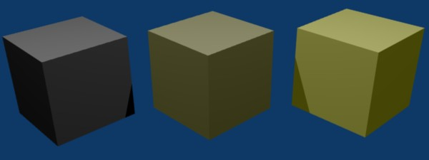
Ambient Light
No identifiable source or direction
Product of multiple reflections of light from the many surfaces present in the environment
Computationally inexpensive
Notes:
The scenes we observe around us always seem to be bathed in some soft non-directional light → Ambient light

Slide 5
Ambient Light
Categories:
Global ambient light
Independent of light source
Lights entire scene
Example: reflection of sunlight from several surfaces
Local ambient light
Contributed by additional light sources
Can be different for each light and primary color
Example: Reflection of fluorescent lamps from several surfaces
Notes:
Global ambient light – sunlight comes through window, get reflected from several surfaces
Local ambient light – tube light get reflected from several surface

Slide 6
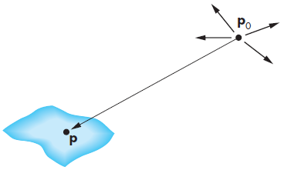
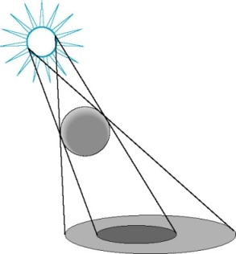

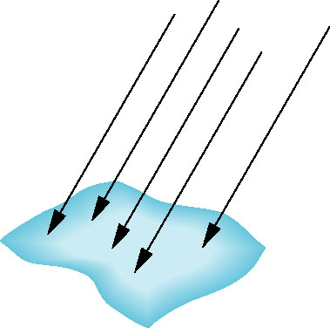
Diffuse Light
Point Source
Given by a point
Light emitted equally in all directions
Intensity decreases with square of distance
Point source [x y z 1]^{T}
At point p, intensity received :
Directional Source
Given by a direction
Simplifies some calculations
Intensity dependents on angle between surface normal and direction of light
Distant source [x y z 0]^{T}
Notes:
Point Source: I is proportional to 1/d²

Slide 7
Ambient Light vs Diffuse Light
Diffuse light
Ambient Light

Slide 8
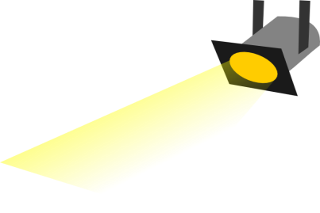
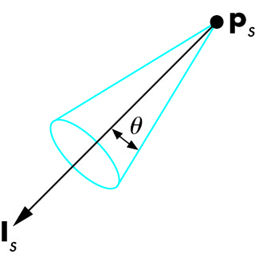
Spot Light
Spotlight is a point source that emits light in restricted set of directions,
Requires color, point, direction, falloff parameter
usually direction boundary forms a cone shape.
Here θ is Cutoff Cone. No light is seen at points lying outside Cutoff angle.
Intensity falls off directionally

Slide 9
Spot Light
Consider, a spot light aimed at direction d.
β is the angle between aimed direction d and a line from source to object P
Source has cut off angle α and intensity I
Intensity of spot light received at P is
Intensity at P = I cos^{ε}(β)
α
d
β
P

Slide 10
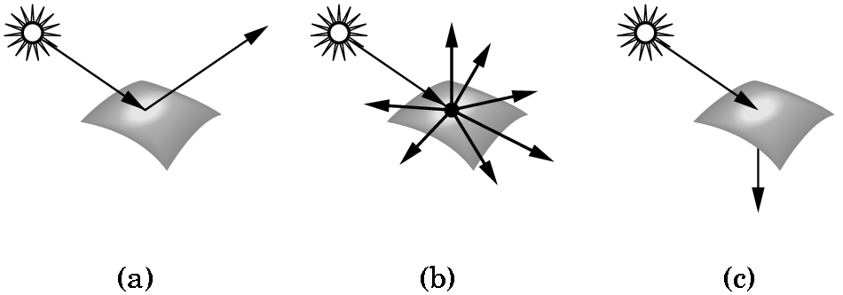
Types of Surface
Interaction between light and material can be classified as
Specular surfaces – Ideal mirror
Diffuse surfaces – Reflected light is ideally reflected to all directions uniformly
Translucent surfaces – Allow some lights to penetrate the surface (e.g. refraction in glass, water)
Notes:
So far what we have seen is the intensity of incident light at some surface point. Now we will compute intensity of reflected light at some surface point.
Assumption: incident light is fully reflected

Slide 11
Reflection
Interaction between light and material can be classified as
Specular reflection – Ideal mirror
Diffuse reflection – Reflected light is ideally reflected to all directions uniformly
* Usually both specular and diffuse reflection can take place at each of type of surface (e.g. mentioned as specular surface, diffuse surface or translucent surface), but their amounts depends on the surface property.

Slide 12
Ideal Diffuse Reflection
Assumes surface reflects equally in all directions.
An ideal diffuse surface is, at the microscopic level, a very rough surface.
Example: chalk, clay, some paints
Surface

Slide 13
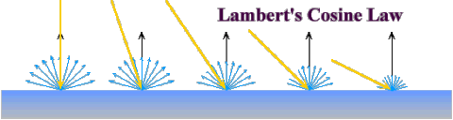
Ideal Diffuse Reflection
Ideal diffuse reflectors reflect light according to Lambert's cosine law.
Lambert's law determines how much of the incoming light energy is reflected. The reflected intensity is independent of the viewing direction.
But reflected light intensity depends on incident angle of light.

Slide 14
Ideal Diffuse Reflection
Suppose light is incident on diffuse surface S.
m = direction of Normal of the surface
v = viewer’s direction
s = direction of incident light
θ = incident angle
I_{s} = Intensity of Light Source
Intensity of reflected light, I_{d}
I_{d}= I_{s} ρ_{d} (s.m/|s||m|) , where ρ_{d} is the diffuse reflectance coefficient.
If θ is negative, then I_{d}= max(I_{s} ρ_{d} (s.m/|s||m|) ,0)
s
m
θ
v

Slide 15
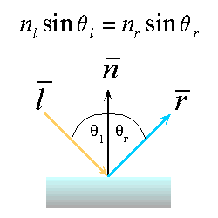
Ideal Specular Reflection
Reflection is only at mirror angle. An ideal mirror is a purely specular reflector.
View dependent reflection. That is, reflected light’s intensity varies with viewer’s position.
Intensity of refelcted light is stronger near mirror angle and strongest at mirror angle.
An Ideal specular reflection follows Snell’s Law.
Snell’s Laws:
The incoming ray and reflected ray lie in a plane with the surface normal
The angle that the reflected ray forms with the surface normal equals the angle formed by the incoming ray and the surface normal

Slide 16
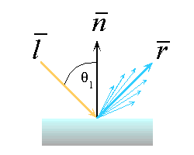
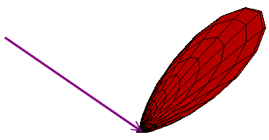
Non-ideal Reflectors
Simple Empirical Model:
We expect most of the reflected light to travel in the direction of the ideal ray.
However, because of microscopic surface variations we might expect some of the light to be reflected just slightly offset from the ideal reflected ray.
As we move farther and farther, in the angular sense, from the reflected ray we expect to see less light reflected.

Slide 17
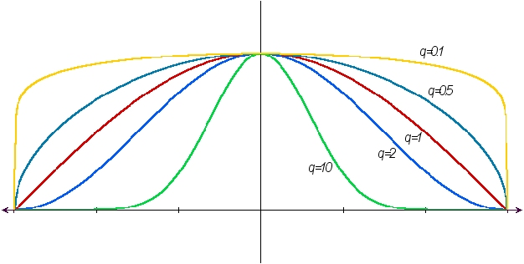
Non-ideal Reflectors
Phong model approximates the fall off of specular reflection.
The cosine term is maximum when the surface is viewed from the mirror direction and falls off to 0 when viewed at 90 degrees away from it.
A scalar (shiny property, q in the figure below, which is the exponent term, k in the specular reflection formula of slide 20) controls the rate of this fall off
Specular reflectance
- angle
angle
-90⁰
0⁰
90⁰

Slide 18
Phong Model
Compute the combined impact of ambient light, diffuse and specular reflection at a point on surface
Also called Local Illumination model as its main focus is on the direct impact of light coming from a source.
This model has no physical basis, yet it is one of the most commonly used illumination models in computer graphics.

Slide 19
Phong Model
Also models secondary effect of light.
Consider a point light source p and viewpoint v. What should be color of light reflected into viewer’s eye from point Q of the surface?
Consider diffuse component, specular component of the incident light and ambient light present in the environment
N
P
R
V
L
θ
θ
φ
Q

Slide 20
Mathematical Calculation of Phong Model
First we consider, 2 extreme cases of light reflection.
Diffuse Reflection : I_{d} α cosθ
= I_{p} k_{d} cosθ [Using k_{d} instead of previous ρ_{d}] = I_{p} k_{d} (L.N)
Specular Reflection:
I_{s} α (cosφ )^{k} = I_{p} k_{s} (cosφ )^{k} = I_{p} k_{s} (R.V)^{k}
* I_{p} is the intensity of the light source
N
P
R
V
L
θ
θ
φ
Q

Slide 21
Mathematical Calculation of Phong Model
We need to ircorporate the effect light present in environment. Thus total refelcted light also includes ambient component.
Ambient Component = I_{a}k_{a}
Total reflected light intensity from Q,
I = Ambient Component + Diffuse Component + Specular Component
= I_{a}k_{a} + I_{p} k_{d} (L.N) + I_{p} k_{s} (R.V)^{k}
More specifically,
I = I_{a}k_{a} + I_{p} [k_{d} max {(L.N),0} + k_{s} max{(R.V)^{k} ,0}]

Slide 22
Additional Issues
When there are n light sources in the scene, their effects are cumulative: Intensity at Q,
I = I_{a}k_{a} + ∑_{(i=1 to n)} I_{pi} {k_{d} (L.N) + k_{s} (R.V)^{k} }
The intesnsity of red, green and blue component of reflected light,
I_{r} = I_{a}k_{ar} + I_{p} k_{dr} (L.N) + I_{p} k_{s} (R.V)^{k}
I_{g} = I_{a}k_{ag} + I_{p} k_{dg} (L.N) + I_{p} k_{s} (R.V)^{k}
I_{b} = I_{a}k_{ab} + I_{p} k_{db} (L.N) + I_{p} k_{s} (R.V)^{k}
k_{s} : coefficient for specular component which is same as the color of light source, not affected by surface color.

Slide 23
How to get vector R ?
Find a formula to compute R, the reflection of vector L with respect to normal vector?
R = 2 (L.N)N – L
(See Solved Problem 11.10 in Schaum(2nd edition))

Slide 24
Blinn and Torrence Variation
Calculation of R is computaionally expensive. So in phong model the term R.V is somtimes replaced by N.H , where H is a unit vector that bisect the angle between L and V.
angle between N and H measures the falloff of intensity.
Though calculation of N.H is is computaionally inexpensive relative to R.V, but N.H is not always equal to R.V. In that case calculation of specular component will be approximate.
(See Solved Problem 11.11 in Schaum(2nd edition)))

Slide 25
Effect of the Reflection Coefficients
Diffuse Reflection Coefficient, k_{d}
Ambient Reflection Coefficient, k_{a}
Specular Reflection Coefficient, k_{s}
Specular Component Exponent Term, k
* To observe the effects of different components, vary one component and keep the other two constant.

Slide 26
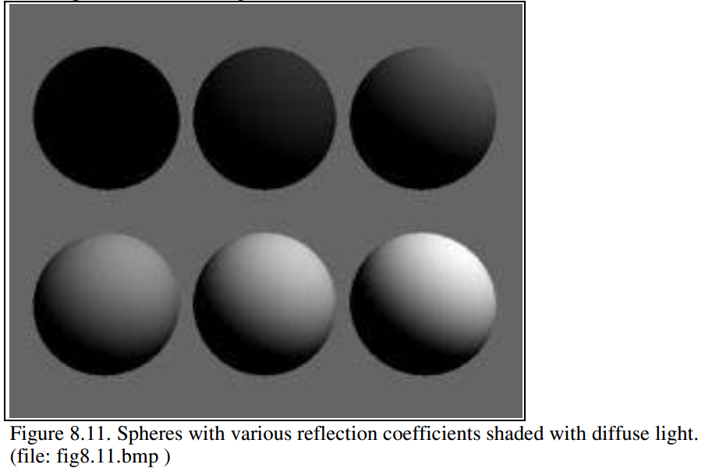
Diffuse Reflection Coefficient
I_{d} = max {I_{s} k_{d} cosθ, 0}
Source intensity is 1.0
Background intensity is 0.4
Sphere reflecting diffuse light, for six reflection coefficients: 0, 0.2, 0.4, 0.6, 0.8, and 1.
Angle θ between surface normal and incident light is > 90º
What is the ambient component here?
What is the specular component?
Notes:
Note that the sphere is totally black when kd is 0.0,
the shadow in its bottom half is also black. Since there the angle between surface normal and incident light is > 90 (dot product is negative)

Slide 27
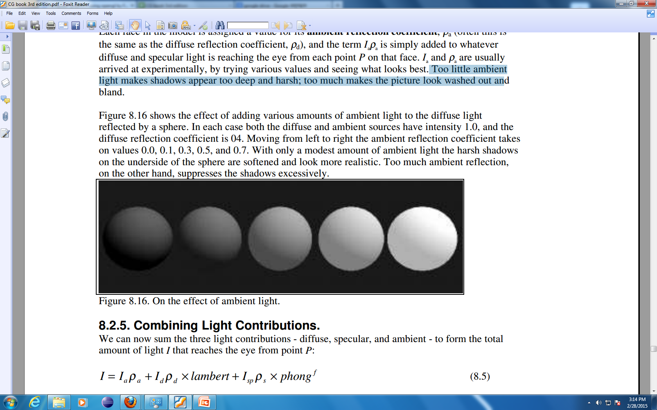
Ambient Reflection Coefficient
Effect of adding ambient light to the diffuse light reflected by a sphere
Diffuse source intensity is 1.0 Diffuse reflection coefficient is 0.4 Ambient source intensity is 1.0
Moving from left to right the ambient reflection coefficient takes on values: 0.0, 0.1, 0.3, 0.5, and 0.7
Too little ambient light makes shadows too deep and harsh
Too much makes the picture look washed out and bland

Slide 28
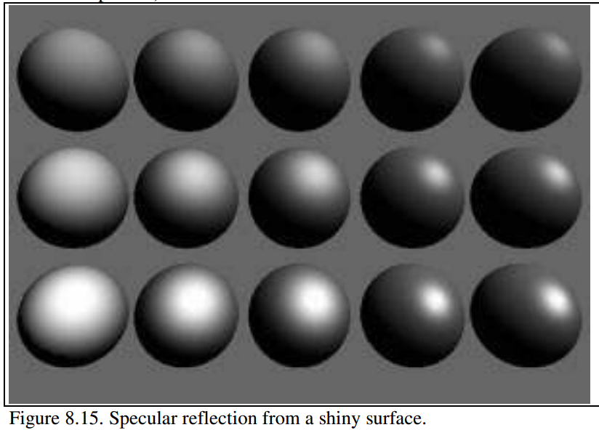
Specular Reflection Coefficient
The ambient and diffuse reflection coefficients are 0.1 and 0.4 for all spheres.
I_{d} = I_{s} k_{s} (cos φ)^{k}
More shiny and more highly concentrated along the direction r
Exponent, k
3
6
9
25
200
More mirror like, more focused reflection with increasing exponent
0.25
reflection coefficient, k_{s}
0.5
0.75
Notes:
As k increases, the reflection becomes more mirror-like and is more highly concentrated from left to right
The reflection coefficient ks varies from top to bottom with values 0.25, 0.5, and 0.75
exponent: user-chosen value that controls the apparent smoothness of the surface.

Slide 29
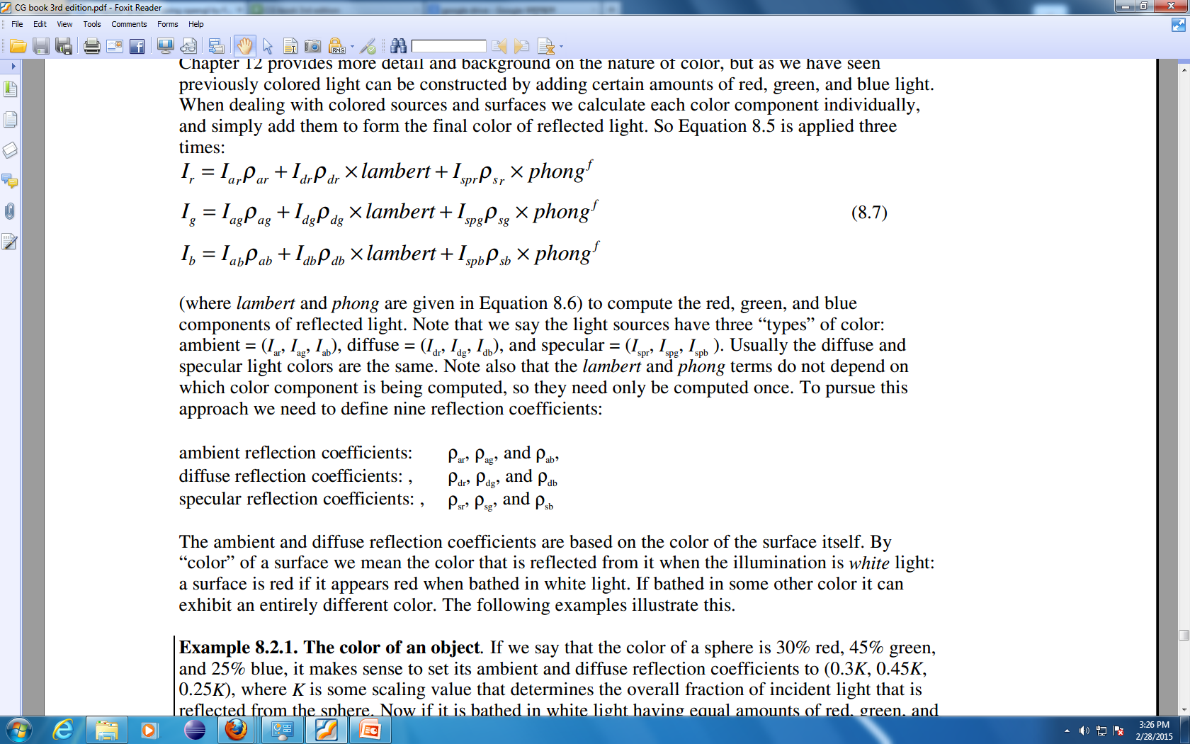
Color
Color is constructed by adding certain amounts of red, green, and blue light
Light sources have three “types” of color:
Surface has two sets of reflection co-efficient
Ambient reflection coefficient : k_{ar} , k_{ag} , k_{ab}
Diffuse reflection coefficient : k_{dr} , k_{dg} , k_{db}
Color of the specular component is often the same as that of the light source – mirror like, so the specular reflection coefficient: k_{sr} , k_{sg} , k_{sb} = k_{s}
e.g. Glossy red apple when illuminated by a yellow light is yellow rather than red

Slide 30
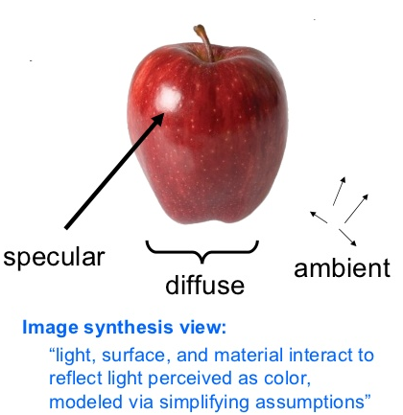
Color of an Object

Slide 31
Color of an Object
By “color” of a surface we mean the color that is reflected from it when the illuminated by white light
The ambient and diffuse reflection coefficients are based on the color of the surface itself.
The specular reflection coefficient is based on the color of the light source (and the roughness property of the surface)
Notes:
A surface is red if it appears red when bathed in white light. If bathed in some other color it can exhibit an entirely different color.

Slide 32
Color of an Object
Color of a sphere is 30% red, 45% green, and 25% blue
Light source in environment: White light (Intensity : I_{sr}= I_{sg}= I_{sb} = I_{s})
Sphere’s ambient and diffuse reflection coefficients: k_{ar} = k_{dr}= 0.30k k_{ag}= k_{dg}= 0.45k k_{ab}= k_{db}= 0.25k
here, k is some scaling value
The individual ambient and diffuse components have intensities I_{ar}= 0.30k I_{a} , I_{dr}= 0.30k I_{s} cosθ I_{ag}= 0.45k I_{a} , I_{dg}= 0.45k I_{s} cosθ I_{ab}= 0.25k I_{a} , I_{ab}= 0.25k I_{s} cosθ
If the environment is uniformly lighted, θ = 0⁰ for sphere!!
Notes:
K is some scaling value that determines the overall fraction of incident light that is reflected from the sphere

Slide 33
Shading
The process of assigning colors to pixels.
Shading
Flat Shading
Smooth Shading
Gouraud Shading
Phong Shading

Slide 34
Shading Model
Flat Shading
Compute Phong lighting once for entire polygon
Gouraud Shading
Compute Phong lighting at the vertices and interpolate lighting values across polygon
Phong Shading
Interpolate normals across polygon and perform Phong lighting across polygon

Slide 35
Flat Shading
For each polygon
Determines a single intensity value at a chosen point on the polygon
Uses that value to shade the entire polygon
Assumptions
Light source at infinity
Viewer at infinity
The polygon represents the actual surface being modeled

Slide 36
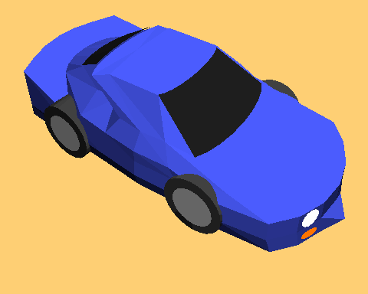
Problems of Flat Shading
Specular highlights tends to get lost
If chosen point on polygon is at location of the light soure, then color of the polygon will be significantly distorted.
Flat Shading

Slide 37
Smooth Shading
Introduce vertex normals at each vertex
Used only for shading
Think of as a better approximation of the real surface that the polygons approximate
Finds color value for each point in the polygon individually
Two types
Gouraud Shading
Phong Shading (do not confuse with Phong Lighting Model)

Slide 38
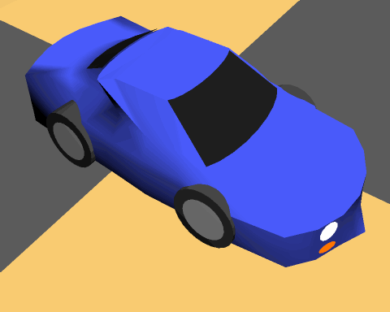
Gouraud Shading
Most common approach
Perform Phong lighting at the vertices
Linearly interpolate the resulting colors over faces
Along edges
Along scanline

Slide 39
Gouraud Shading
y_{top}
color₃
y₄
color₄
color₂
y_{s}
y_{bott}
color₁
x_{left}
x_{right}

Slide 40
Gouraud Shading
y_{top}
color₃
y₄
color₄
color₂
y_{s}
y_{bott}
color₁
x_{left}
x_{right}
Calculate the surface normals along the scan line and the edge using incremental approach

Slide 41
Problem of Gouraud Shading
Often appears dull
Lacks accurate specular component
C₁
C₃
C₂
Can’t shade the spot light

Slide 42
Phong Shading
Interpolate normal vectors of face vertices at each pixel, then perform Phong lighting at each pixel.
m₃
y_{s} - y₁
m_{left} = m₁ + (m₄-m₁)
m₄
m₂
m_{left}
m_{right}
Y₄ - y₁
m_{x}
y_{s} - y₁
y_{s}
m_{right} = m₁ + (m₂-m₁)
m₁
Y₂ - y₁
x - x_{left}
x
m_{x}= m_{left} + (m_{right} - m_{left})
x _{right} - x_{left}
Calculate the surface normals along the scan line and the edge using incremental approach

Slide 43
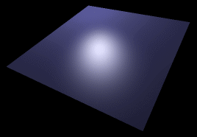
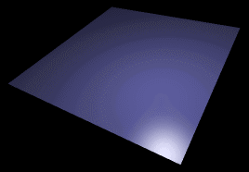
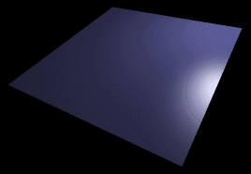
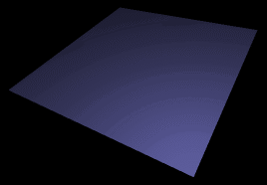
Phong vs Gouraud Shading
Phong shading is more smooth
If a highlight does not fall on a vertex, Gouraud shading may miss it completely, but Phong shading does not.

Slide 44
Texture
Texture Types
Bitmap textures: Using some image file
Procedural textures: Changing pixel intensity in some controlled fashion without using external image source
Texture (s, t) produces a color or intensity value for each value of s and t between 0 and 1

Slide 45
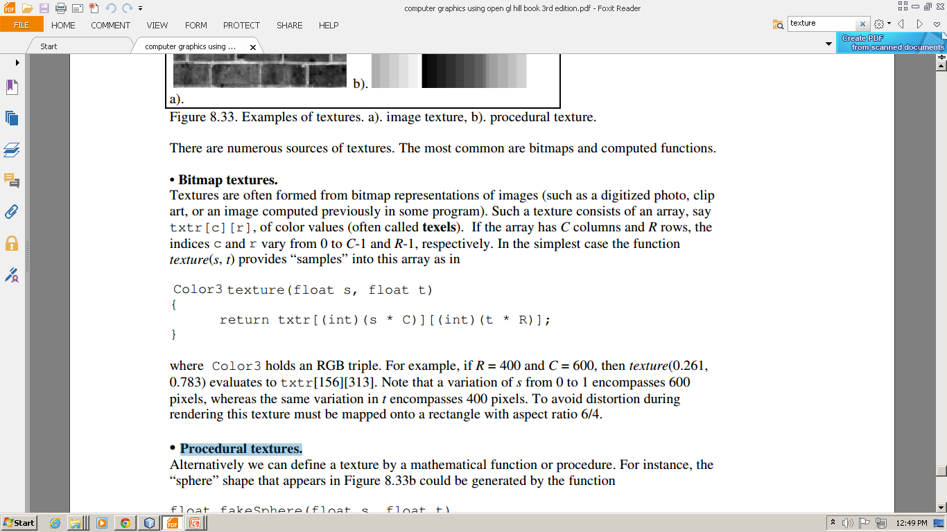
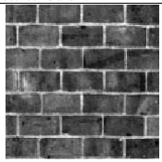
Texture
Bitmap textures: Using some image file having dimension CxR presented as txtr[c][r]
0<=c<=C-1 and 0<=r<=R-1
Example: C= 600 and R= 400 texture(0.261,0.783) evaluates to txtr[156][313] texture(1,1) evaluates to txtr[600][400]

Slide 46
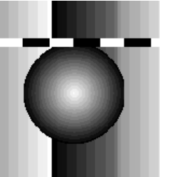
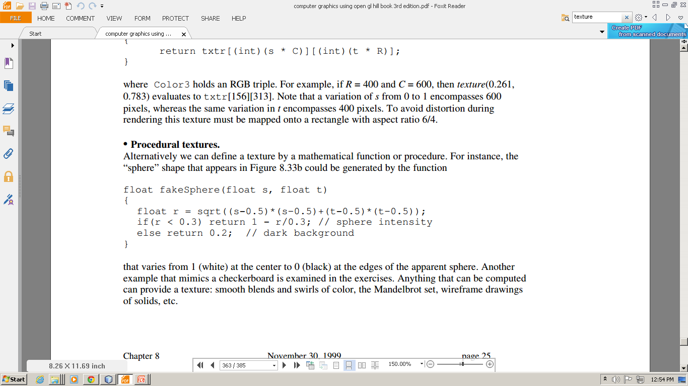
Texture
Procedural textures: Changing pixel intensity in some controlled fashion without using external image source
Not used frequently
(Bitmap textures that is image files are commonly used)

Slide 47
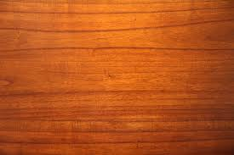
Texture
Adding Texture to Flat Surface
Texture P and Surface S has
same shape
Same number of vertices
Attaching a P_{i} to each V_{i}
P₂(0,1)
P₃(1,1)
V₂
V₃
P₁(0,0)
P₄ (1,0)
V₁
V₄
T(s,t)

Slide 48
Texture
Adding Texture to Flat Surface
Texture P and Surface S has same shape
glBegin(GL_QUADS);
glTexCoord2f(0.0, 0.0); glVertex3f(1.0, 2.0, 1.5);
glTexCoord2f(0.0, 1.0); glVertex3f(1.0, 3.0, 1.5);
glTexCoord2f(1.0, 1.0); glVertex3f(2.0, 3.0, 1.5);
glTexCoord2f(1.0, 0.0); glVertex3f(2.0, 2.0, 1.5);
glEnd();
0,1
1,1
Without distortion
=
0,0
1,0

Slide 49
Texture
Adding Texture to Flat Surface
Texture P and Surface S has same shape
glBegin(GL_QUADS);
glTexCoord2f(0.0, 0.0); glVertex3f(1.0, 2.0, 1.5);
glTexCoord2f(0.0, 0.5); glVertex3f(1.0, 3.0, 1.5);
glTexCoord2f(0.5, 0.5); glVertex3f(2.0, 3.0, 1.5);
glTexCoord2f(0.5, 0.0); glVertex3f(2.0, 2.0, 1.5);
glEnd();
0,1
1,1
Stretched
=
0,0
1,0

Slide 50
Texture
Adding Texture to Flat Surface
Texture P and Surface S has same shape
glBegin(GL_QUADS);
glTexCoord2f(0.0, 0.0); glVertex3f(1.0, 2.0, 1.5);
glTexCoord2f(0.0, 2.0); glVertex3f(1.0, 3.0, 1.5);
glTexCoord2f(2.0, 2.0); glVertex3f(2.0, 3.0, 1.5);
glTexCoord2f(2.0, 0.0); glVertex3f(2.0, 2.0, 1.5);
glEnd();
2.0
Tile
0,1
1,1
=
1.5
0,0
1,0

Slide 51
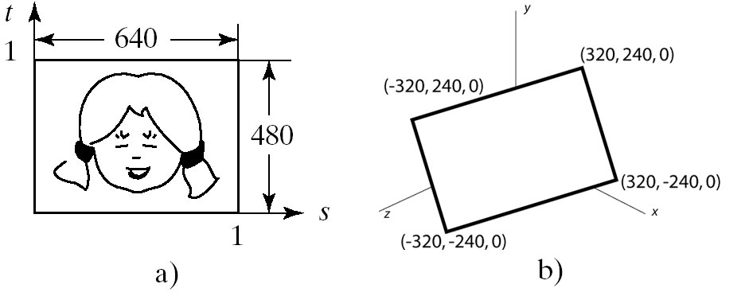
Texture
Adding Texture to Flat Surface
Texture P and Surface S has same shape
Mapping is clearly affine
Scaling
Rotation
Translation

Slide 52

Creating Visual Effect Using Texture
Creating a glowing object
I = texture(s, t)
gl.glEnable(GL.GL_TEXTURE_2D);
gl.glTexEnvf(GL.GL_TEXTURE_ENV, GL.GL_TEXTURE_ENV_MODE, GL.GL_REPLACE);
gl.glBindTexture(GL.GL_TEXTURE_2D, texName);
glBegin(GL_QUADS);
glTexCoord2f(0.0, 0.0); glVertex3f(1.0, 2.0, 1.5);
glTexCoord2f(0.0, 1.0); glVertex3f(1.0, 3.0, 1.5);
glTexCoord2f(1.0, 1.0); glVertex3f(2.0, 3.0, 1.5);
glTexCoord2f(1.0, 0.0); glVertex3f(2.0, 2.0, 1.5);
glEnd();
=

Slide 53
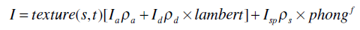
Creating Visual Effect Using Texture
Modulating the reflection coefficient
Object is the color of
Reflected diffuse light component
Reflected ambient light component
gl.glEnable(GL.GL_TEXTURE_2D);
glTexEnvf(GL_TEXTURE_ENV,GL_TEXTURE_ENV_MODE, GL_MODULATE);
gl.glBindTexture(GL.GL_TEXTURE_2D, texName);
glBegin(GL_QUADS);
glTexCoord2f(0.0, 0.0); glVertex3f(1.0, 2.0, 1.5);
glTexCoord2f(0.0, 1.0); glVertex3f(1.0, 3.0, 1.5);
glTexCoord2f(1.0, 1.0); glVertex3f(2.0, 3.0, 1.5);
glTexCoord2f(1.0, 0.0); glVertex3f(2.0, 2.0, 1.5);
glEnd();

Slide 54
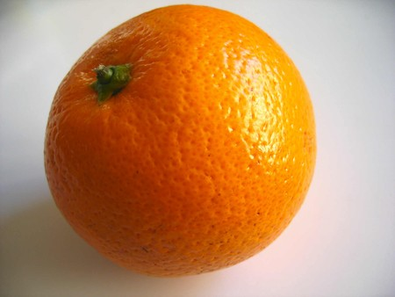
Creating Visual Effect Using Texture
Simulating Roughness by Bump Mapping
Technique to give surface wrinkled or dimpled appearance without having to model each individual dimple
Independent of the viewing angle and object orientation

Slide 55
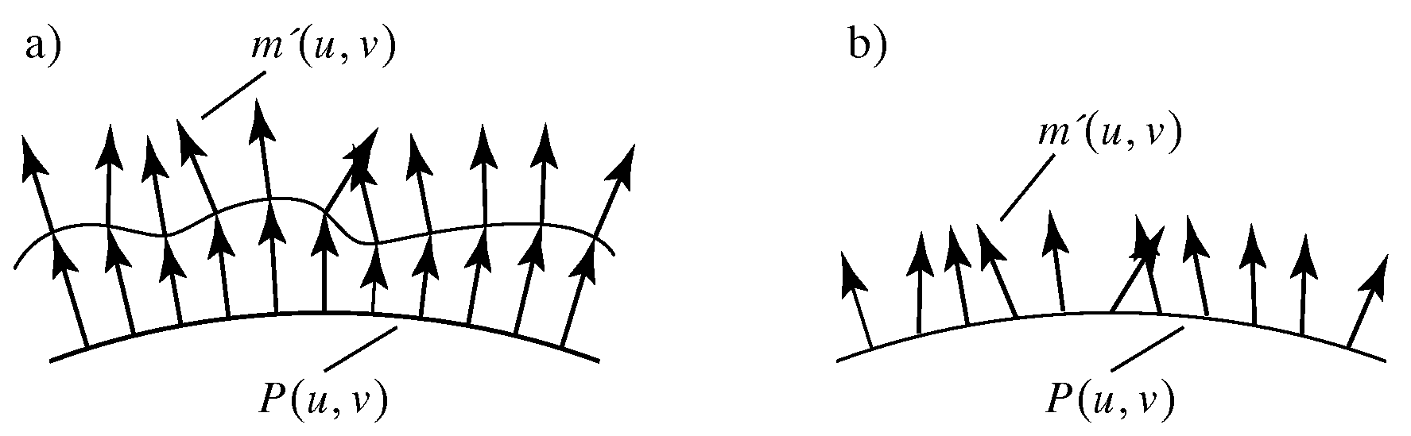
Creating Visual Effect Using Texture
Simulating Roughness by Bump Mapping
Scalar function texture(s, t) perturb the normal vector at each spot in a controlled fashion. It causes perturbations in the amount of diffuse and specular lights.

Slide 56
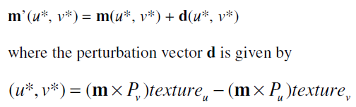
Creating Visual Effect Using Texture
Simulating Roughness by Bump Mapping
Surface is represented parametrically by the function P(u, v)
Surface has unit normal vector m(u, v)
3D point at (u*, v*) corresponds to the texture at (u*, v*)
New normals can be found by:
texture_{u} and texture_{v} are partial derivatives of the texture function wrt u and v

Slide 57
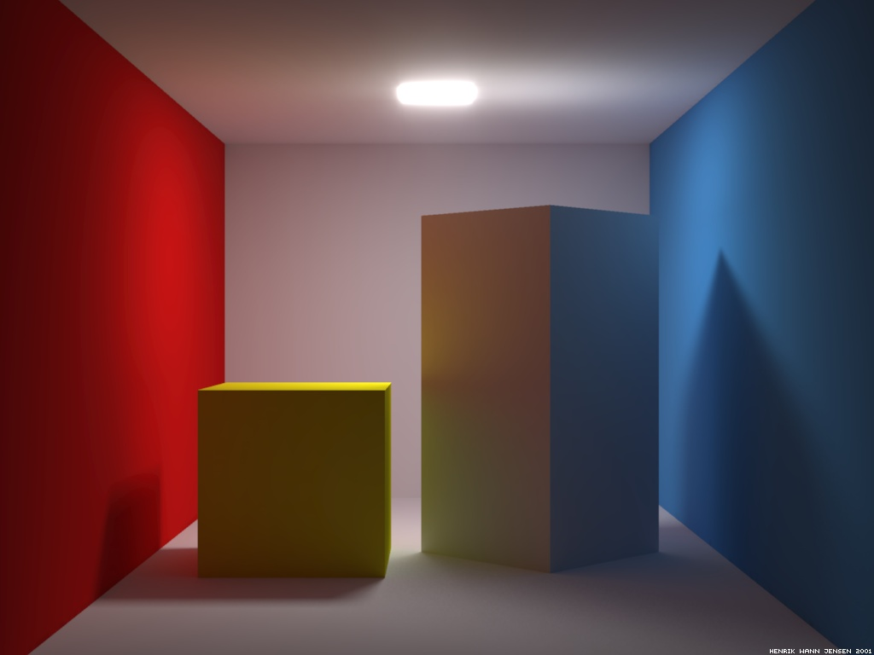
Shadows

Slide 58
Adding Shadows of Objects
Shadows as Texture
Shadows Using a Shadow Buffer

Slide 59
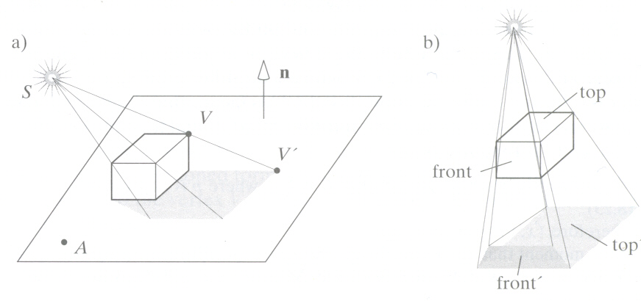
Shadows as Texture
Paint shadows as a texture
Works for flat surfaces illuminated by point light source
Problem: compute shape of shadow

Slide 60
Shadows as Texture
* Union of projections of individual faces = projection of entire object
First, draw plane using specular-diffuse-ambient components
Then, draw shadow projections (face by face) using only ambient component

Slide 61
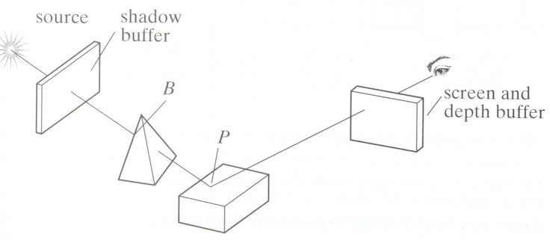
Shadows Using a Shadow Buffer
Shadow Buffer: An auxiliary second depth buffer
Any points in the scene that are “hidden” from the light source must be in shadow.
If no object lies between a point and the light source the point is not in shadow.

Slide 62
Shadows Using a Shadow Buffer
Contains a “depth picture” of the scene from the point of view of the light source
Each of its index (i, j) records the distance from the source to the closest object in the associated direction.

Slide 63
Shadows Using a Shadow Buffer
Step 1: Loading Shadow Buffer:
Initialize each index value d[i][j] to 1.0
Position a camera at light source
Rasterize each face in scene updating pseudo-depth
Shadow buffer tracks smallest pseudo-depth so far

Slide 64
Shadows Using a Shadow Buffer
Step 1: Loading Shadow Buffer:
Shadow buffer calculation is independent of eye position
In animations, shadow buffer loaded once
If eye moves, no need for recalculation
If objects move, recalculation required

Slide 65
Shadows Using a Shadow Buffer
Step 2: Rendering Scene:
Render scene using camera as usual
While rendering a pixel [c][r], find:
pseudo-depth D from light source to P
Index location [i][j] in shadow buffer, to be tested
Value d[i][j] stored in shadow buffer

Slide 66
Shadows Using a Shadow Buffer
Step 2: Rendering Scene:
If d[i][j] < D (other object on this path closer to light)
point P is in shadow
set lighting using only ambient
Otherwise, not in shadow

Slide 67
Thank you ☺

